Slide 1
SUPPORT VECTOR MACHINE
BHUVANESHWARI PATIL

Slide 2
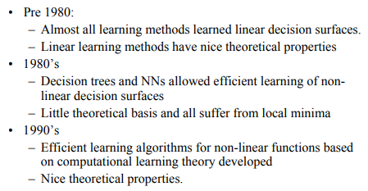
Introduction

Slide 3
SVM: A New Generation of Learning Algorithms
A classification that has received considerable attention is support vector machine and popularly abbreviated as SVM.
This technique has its roots in statistical learning theory by Vlamidir Vapnik, 1992.
It searches for optimal hyper plane separating the tuples of one class from another.
Works well with higher dimensional data
avoids dimensionality problem.
The training time is more however highly accurate.
Testing an unknown data is very fast.
Less prone to over fitting than other methods.
Facilitates compact model for classification.

Slide 4
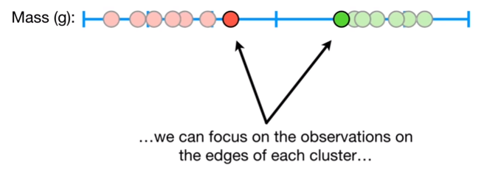
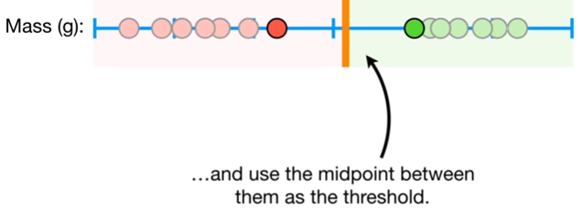
Support Vector Machine

Slide 5
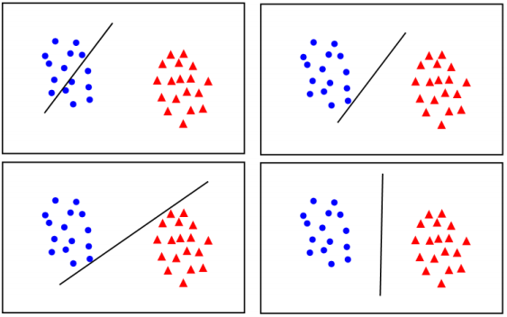
The different classification lines
Is there any reason why one is better than the others?

Slide 6
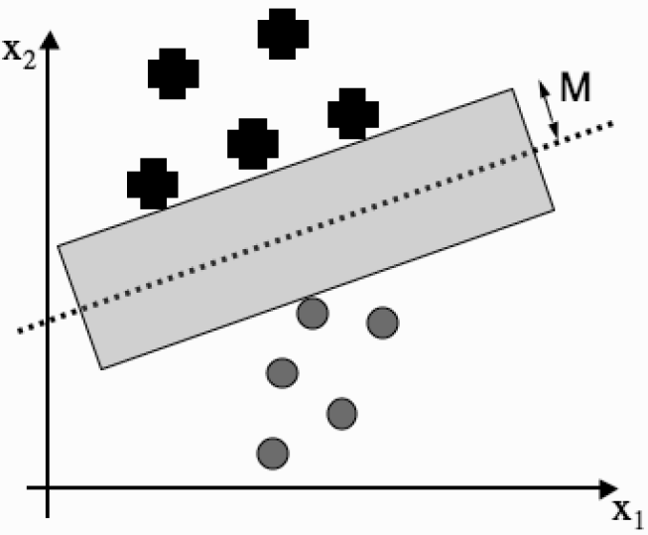
Maximum Margin (M)

Slide 7
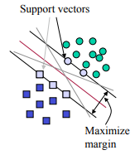
Support Vectors
Support vectors are the data points that lie closest to the decision surface (or hyper plane)
They are the data points most difficult to classify
They have direct bearing on the optimum location of the decision surface

Slide 8
Support vectors
SVM maximize the margin around the separating hyper plane.
The decision function is fully specified by a (usually very small) subset of training samples, the support vectors.
This becomes a Quadratic programming problem that is easy to solve by standard methods

Slide 9
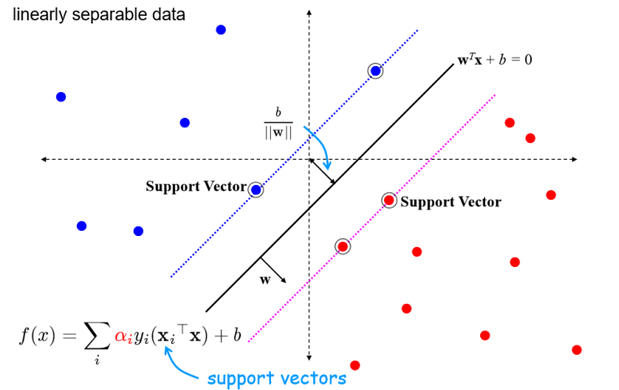

Slide 10
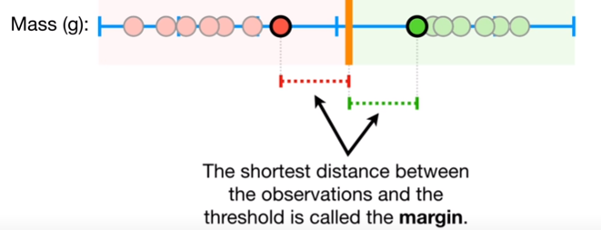
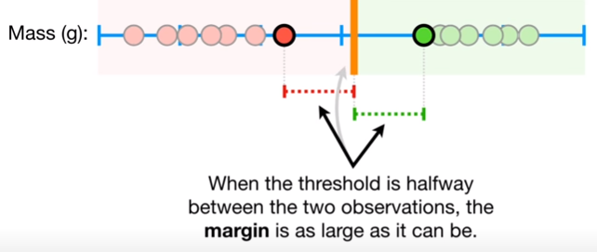
Criteria
The margin should be as large as possible
The support vectors are the most useful data points

Slide 11
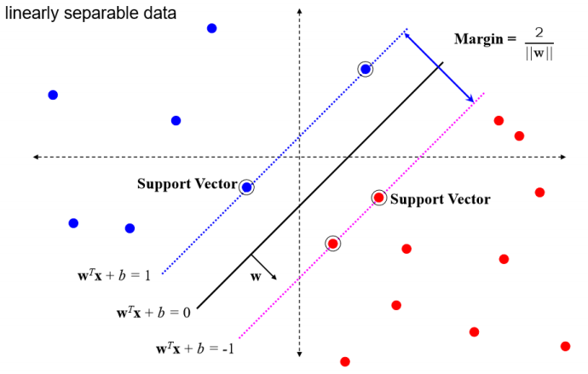
SVM

Slide 12
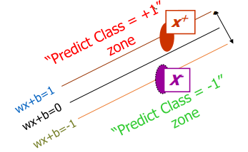
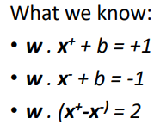
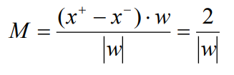
Linear SVM Mathematically

Slide 13
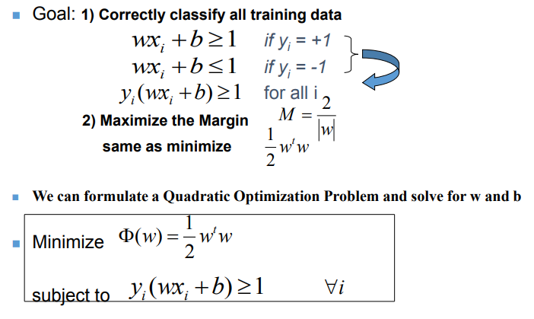
Steps involved

Slide 14
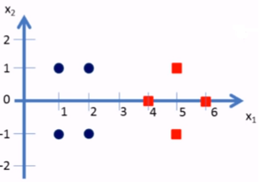
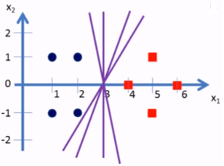
SVM - Numerical Example
Use SVM to draw a separation line between positive and negative data points given as (1,1),(2,1), (1,-1),(2,-1),(4,0),(5,1),(5,-1) and (6,0)

Slide 15
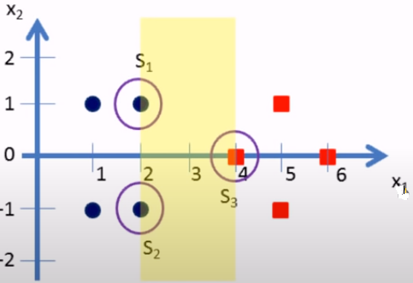
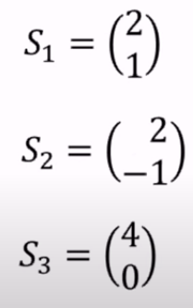
Support vectors

Slide 16
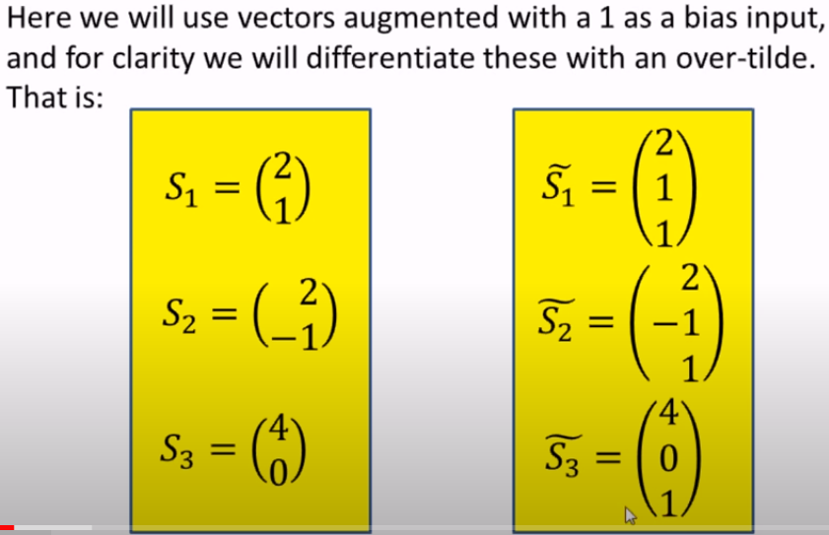
Modifying the support vectors - biasing

Slide 17
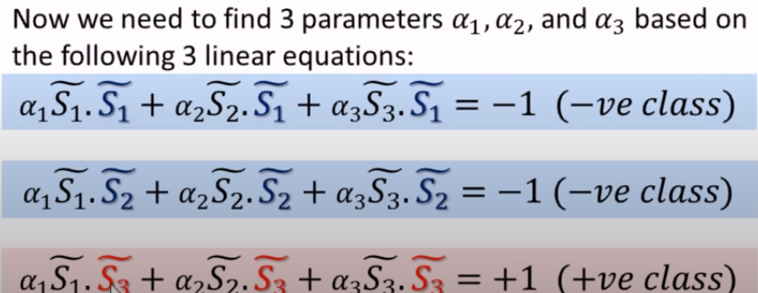
Finding parameters

Slide 18
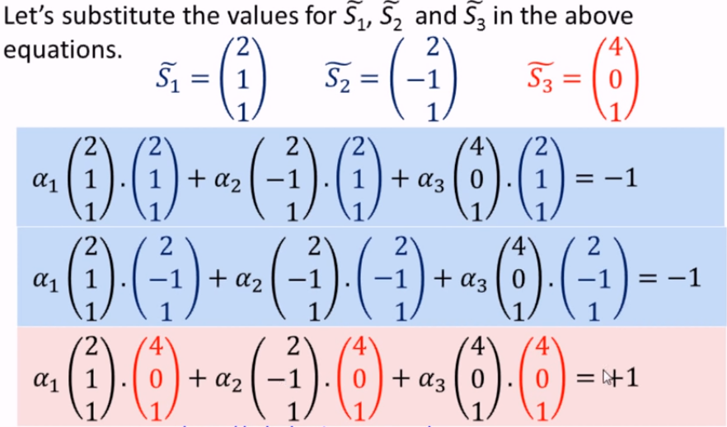
Solving linear equations

Slide 19
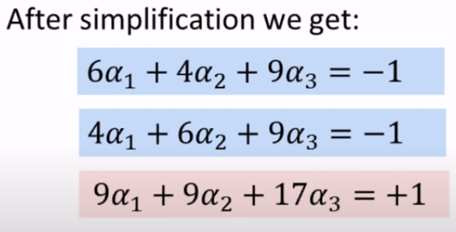

Simplification

Slide 20
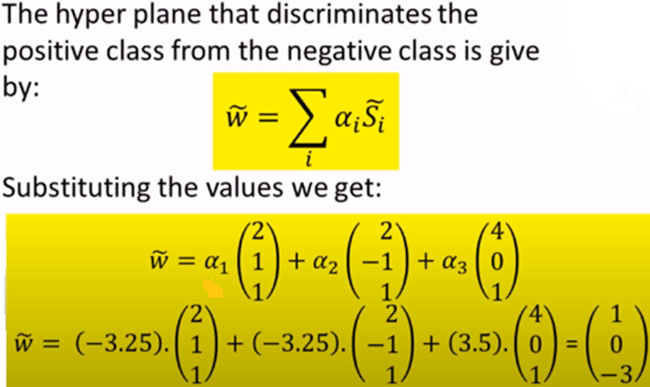
Hyper plane equation

Slide 21
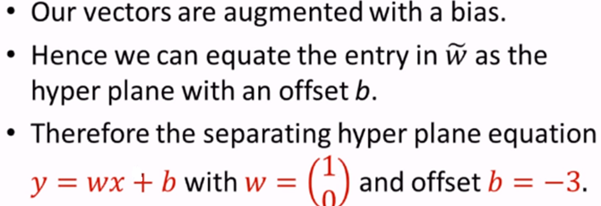
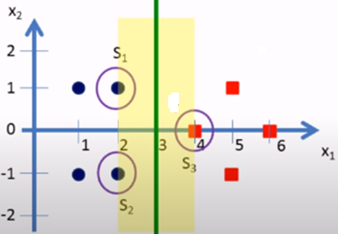
Maximization margin

Slide 22


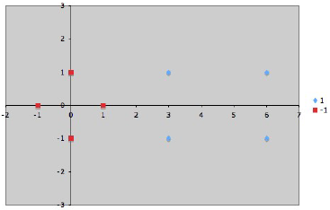

Example 2

Slide 23


Solving simultaneous equations

Slide 24



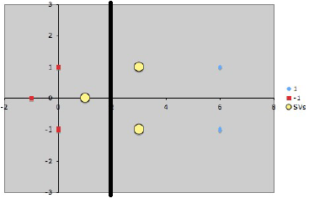
Discriminating hyper plane

Slide 25
Non Linear SVM

Slide 26
Non-linear SVM
Work out how to formulate the problem so
that it can be presented to a quadratic program solver
Since the problem is quadratic, there is a unique optimum solution
Introducing Slack Variables - added to an inequality constraint to transform it into an equality
Using Kernel functions

Slide 27
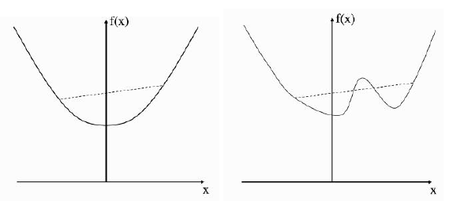
Convex function
Convex
Non Convex

Slide 28
Lagrange Multipliers with inequality constraints (KKT conditions)
KKT - Karush–Kuhn–Tucker (KKT) conditions
The first derivative tests (sometimes called first-order necessary conditions) for a solution in nonlinear programming to be optimal, provided that some regularity conditions are satisfied.
the KKT conditions are necessary and sufficient for w, b, α to be a solution
For more details refer:
https://www.researchgate.net/publication/335099466_Lecture_Notes_on_Machine_Learning_The_Karush-Kuhn-Tucker_Conditions_Part_2
https://www.youtube.com/watch?v=eREvLgRJWrE

Slide 29
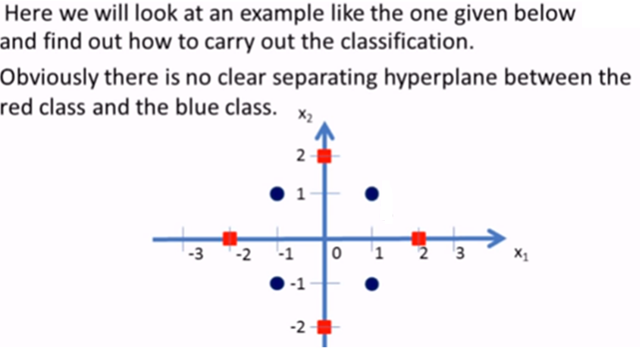


SVM for nonlinear data - Example

Slide 30
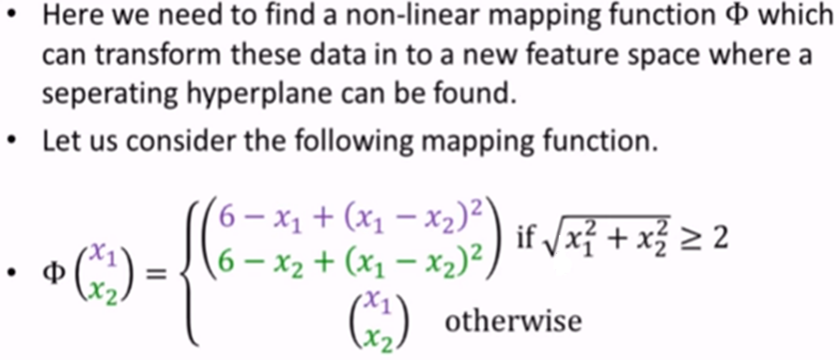
Identifying mapping function

Slide 31
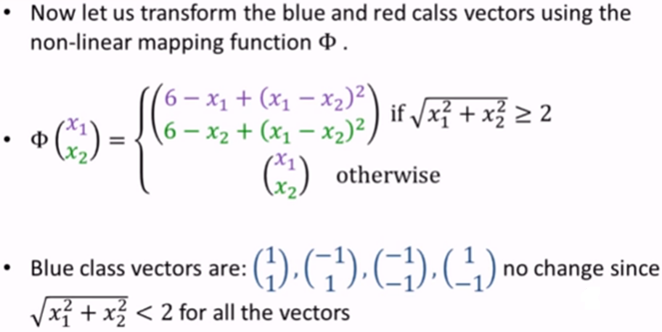
Transformation

Slide 32
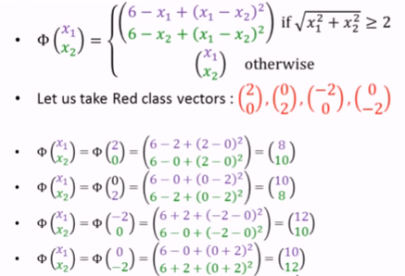
Transformation

Slide 33
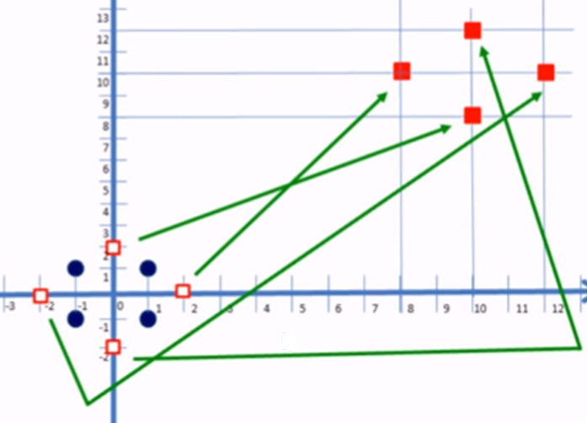
Data points after transformation
Non-linear data is converted into linear
Easy to separate

Slide 34
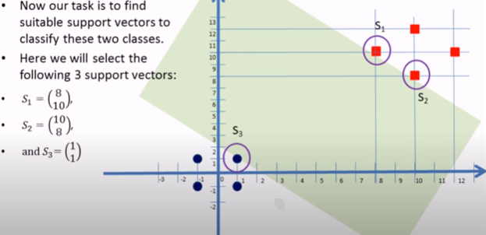
Support vectors

Slide 35
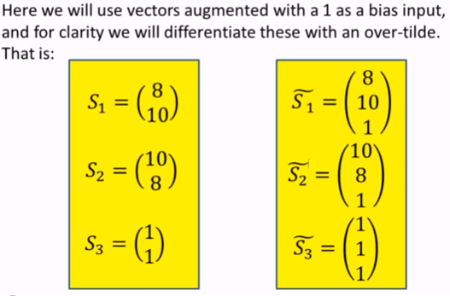
Support vectors - bias

Slide 36
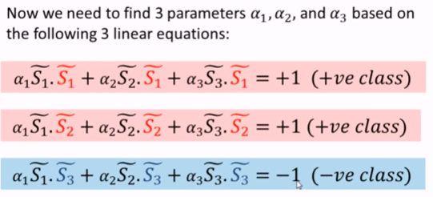
Finding parameters

Slide 37
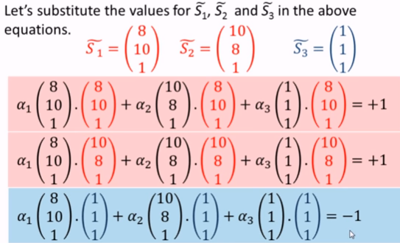
Simultaneous equations

Slide 38
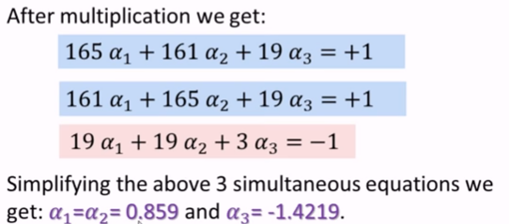
Solving simultaneous equations

Slide 39
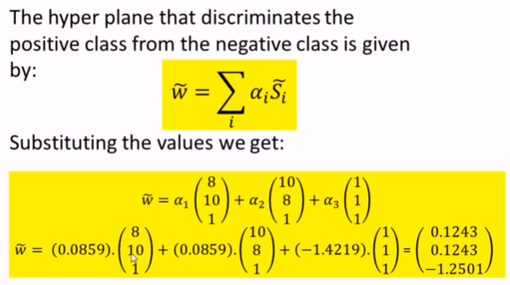
Discriminating Hyperplane

Slide 40
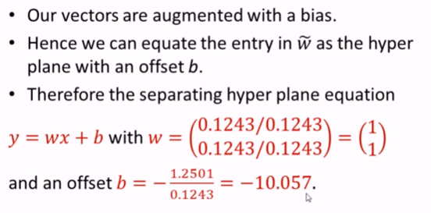
Equation for discriminating Hyper plane

Slide 41
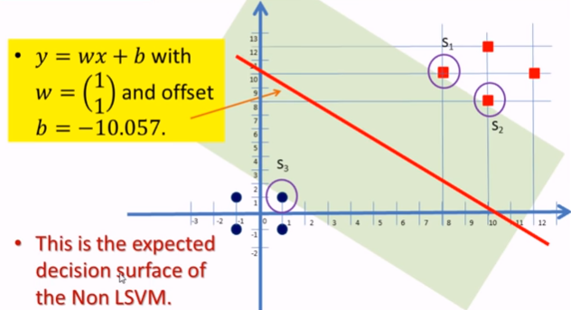
Hyper plane separating two classes

Slide 42
Summary
SVM, support vector machine is use for both linear and non linear data points
Two class problem
Introduced by Vapnik in 1992
Discussed the concepts like margin, hyper plane, support vectors, slack variables, kernel function, etc.
Model is build using support vectors from both +ve and -ve classes
Solved numerical example for both linear and non linear data points

Slide 43
THANK YOU

